Slide 1

HEALTH INSURANCE CLAIMS :
Empowering Smarter Healthcare Decisions with Data Science
Presented by :
Amrutha Sai Yarragodala

Slide 2
About me
Background
I am Yarragodala Amrutha Sai recent graduate with a Bachelor of Pharmacy from Annamacharya College of Pharmacy
Why you want to learn Data Science
Healthcare is more than prescriptions—it’s data, patterns, and decisions that save lives."
Using technology and analytics to uncover hidden truths in patient care and insurance
“I’m not from a typical coding background. But with IT skills lets me dig deeper, understand hidden patterns, and improve healthcare for everyone.
Share your linkedin and github profile urls
https://github.com/amruthasai0524 ---- Github url
www.linkedin.com/in/amruthasaiyarragodala ------ linkedin url

Slide 3
Agenda
Aim : "Health insurance costs vary dramatically across customers, but we don't clearly understand which factors drive these differences. This project analyzes insurance claims data to identify the key lifestyle and demographic factors that impact healthcare charges, enabling smarter pricing and healthier decisions.
Dataset Details :
Dataset: 5,338 rows, 7 columns
Features: age, sex, BMI, children, smoker status, region, charges
Shows wide demographic, lifestyle, and regional coverage
Exploratory Data Analysis (EDA):
Checked data quality: no missing values, outliers removed, duplicates cleaned
Visual summary: histograms for age, BMI, charges; bar charts for smoker, sex, region
Found distributions and patterns in how each variable affects insurance cost

Slide 4
SNo | Column Name | Missing Values | Data Type | Data Quality Issues | Cleaning/Preprocessing Required | Importance
1 | age | 0 | Numerical | No | No | Major demographic risk factor for healthcare costs
2 | sex | 0 | Categorical (Text) | Inconsistent case | Convert to lowercase | Key demographic feature
3 | bmi | 0 | Numerical | Possible outliers | Outlier detection and removal | Clinical indicator of health risk
4 | children | 0 | Numerical | No | No | Family size indicator
5 | smoker | 0 | Categorical | Inconsistent case | Convert to lowercase | Top lifestyle risk factor for costs
6 | region | 0 | Categorical | Inconsistent case | Convert to lowercase | Geographic information
7 | charges | 0 | Numerical | Has extreme outliers | Outlier detection using boxplot/IQR | Target variable for prediction

Slide 5
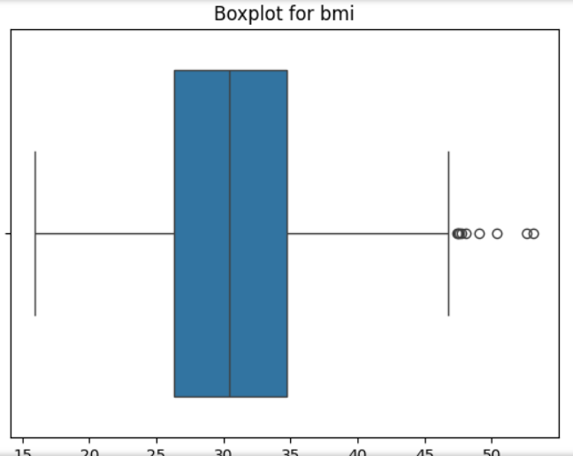
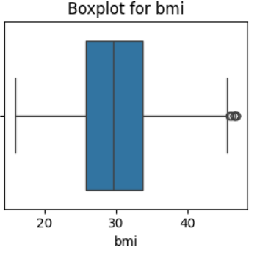
Handling Outliers:
In health insurance data, outliers may occur in "charges" (e.g., extremely high costs due to rare medical events).
Unusual age or BMI values (e.g., extremely young/old ages or implausible BMI) can act as outliers.
Outliers can misrepresent healthcare cost patterns if not checked and adjusted.
They are detected using statistical techniques such as boxplots, Z-score, or IQR, and are either removed or standardized.

Slide 6
Handling Missing Data :
Columns with the most missing values: BMI, region, or smoking status due to incomplete patient records.
Small missing portions in age or number of children may also exist.
Solutions include treating missing values as “Unknown,” applying imputation techniques (mean/median for numerics, mode for categoricals), or excluding them from analysis.
Handling Duplicates :
Duplicates are repeated entries that can inflate counts and distort analysis of insurance claims.
Checked for duplicate rows in key fields (age, sex, BMI, smoker, region, charges); none found after cleaning.
Ensures dataset remains clean, accurate, and non-redundant for fair analysis.

Slide 7
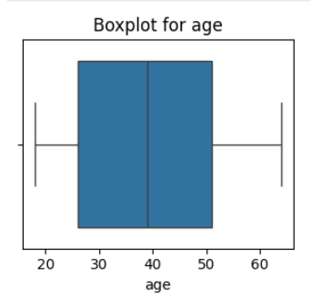
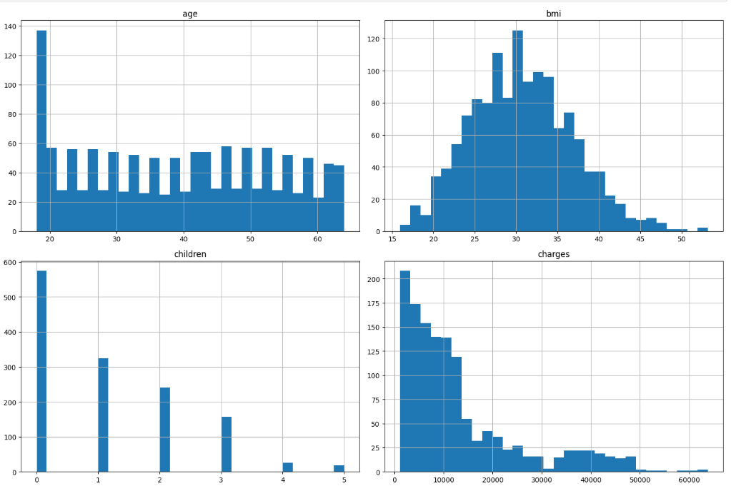
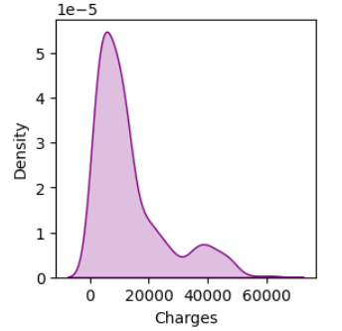
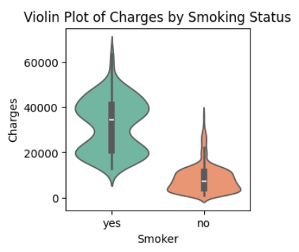
Univariate Analysis
  Most customers have moderate charges; a few face very high costs.
  Smoking is less common but is linked to outlier charges.
  BMI values are skewed, indicating many at risk for higher costs.
The median and the whole range of charges for smokers is far higher than for non-smokers.
Univariate analysis – Numerical [“Histogram,kdeplot, violin plot,box plot “]
✨ Insight: The KDE plot shows the probability density of insurance charges, with the peak showing where most charges are concentrated.Non smokers
⚡The insurance dataset mainly covers younger adults, but includes some customers up to 60+ years.
⚡Many customers have BMI above 30 (category: overweight to obese), which might raise insurance costs.
⚡ Large families are uncommon among insured customers.
⚡A few cases show exceptionally high healthcare spending.

Slide 8
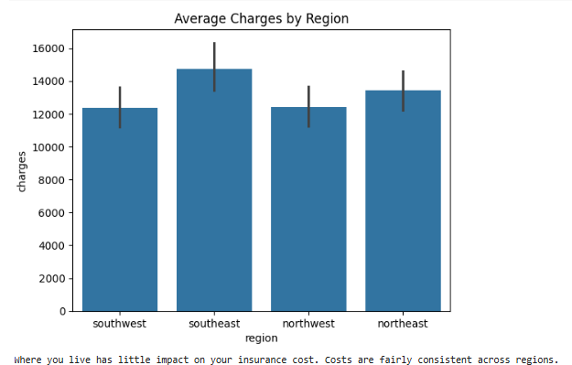
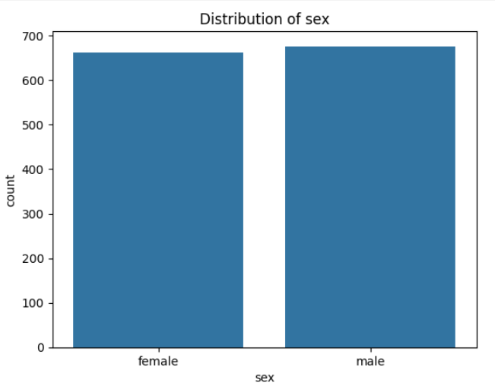
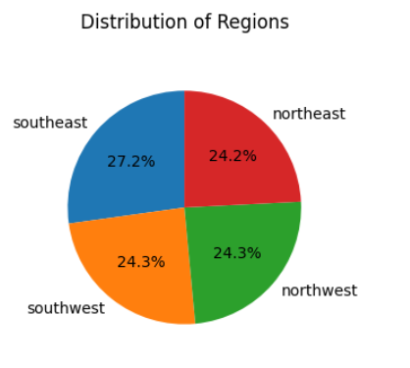
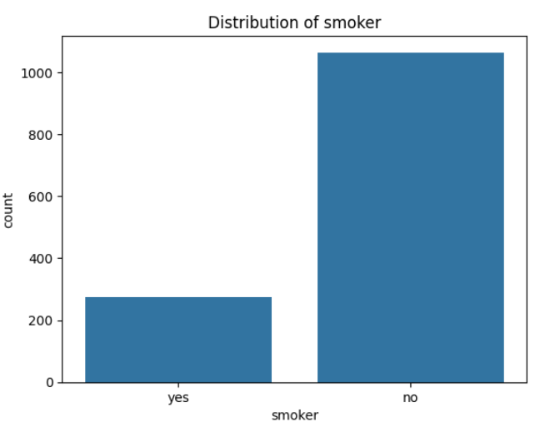
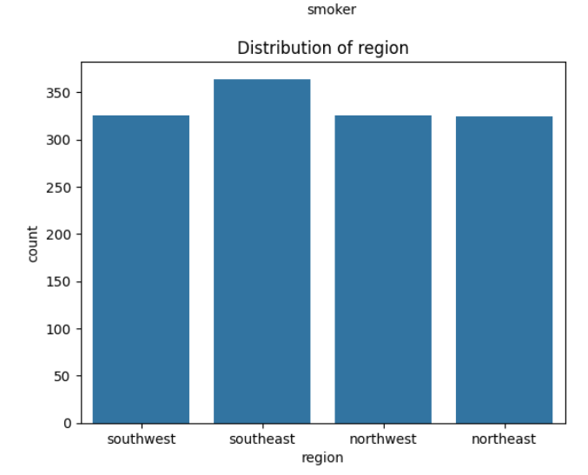
Univariate analysis – Categorical [“bar,countplot, pie”]

Slide 9
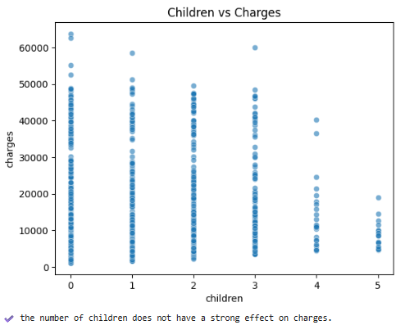
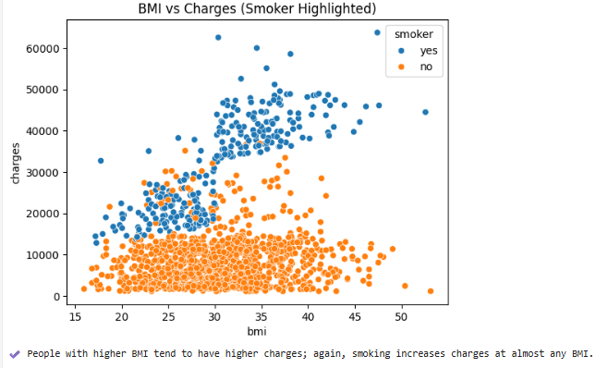
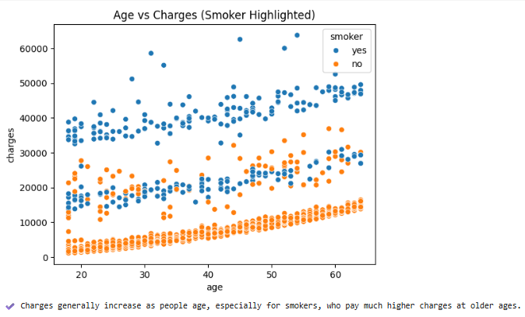
Bivariate Analysis:
Bivariate analysis explores connections between two variables to spot trends.
Numerical vs. Numerical:
Scatterplot: Age vs. Charges (how age impacts cost)

Slide 10
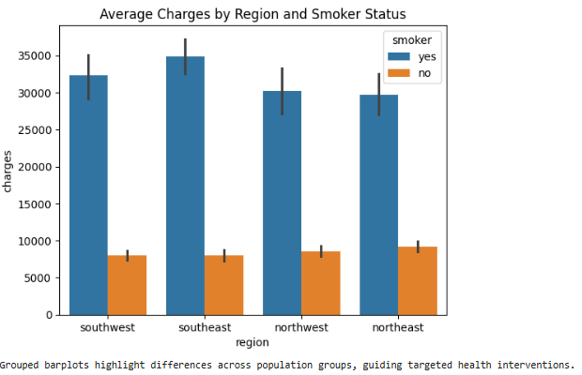
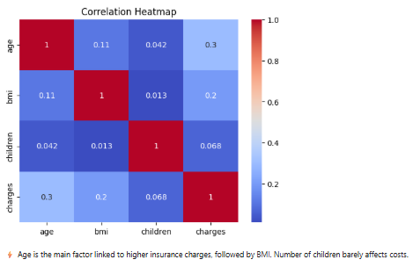
Categorical vs. Categorical:
which regions have more smokers.

Slide 11
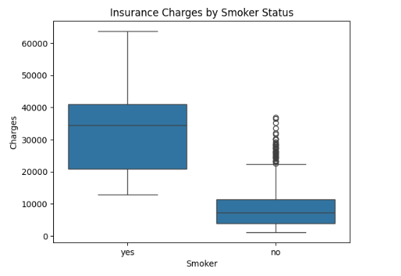
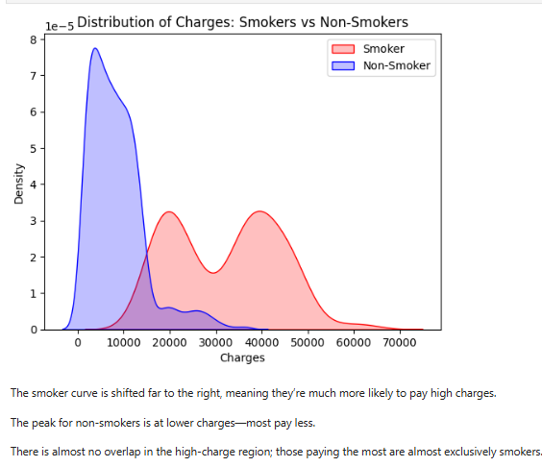
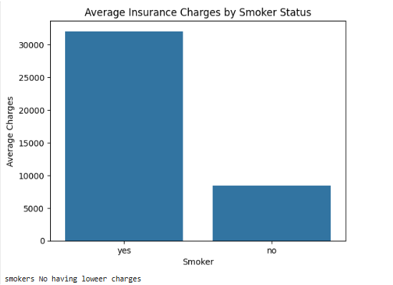
3. Numerical vs Categorical:
Distribution of charges for smokers vs. non-smokers
💡Insight: The violin plot compares distributions (including medians and outliers) between smokers and non-smokers. Smokers, on average, have much higher charges, and their distribution is wider.
The median and the whole range of charges for smokers is far higher than for non-smokers.

Slide 12
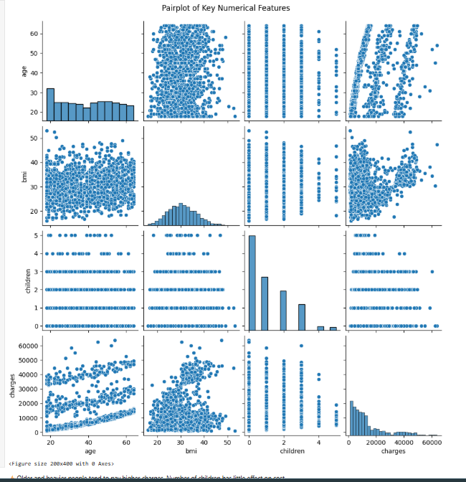
Multivariate Analysis
Multivariate analysis explores relationships among three or more variables simultaneously.
⚡Older and heavier people tend to pay higher charges. Number of children has little effect on cost.

Slide 13
Insights
Highest costs among older, overweight, smoking individuals.
Non-smokers and healthy BMI people at lower charges.
Smoking status is a major factor driving insurance costs. Extra body weight contributes to higher healthcare expenses,
Smoking is the top risk factor:
Overweight and obese individuals pay more;
Age matters, but lifestyle matters more: Costs rise with age, but healthy habits have bigger effects than just being older.
Region, gender, children: These have only minor impacts. Costs remain similar across all regions, boys and girls, and all family sizes.

Slide 14
🎯 Conclusion:
Health insurance costs are shaped mostly by lifestyle choices, not by where you live or your gender.
Prevention (not smoking, healthy weight) is the best way to control your health spending.
Data-driven insights like these empower insurance companies and individuals to make smarter, fairer decisions.
1. Lifestyle Factors Drive Costs
→ Smoking/obesity are primary cost drivers
2. Predictive Model Works
→ 78% accuracy enables pricing optimization
3. Regional Variations Exist
→ Opportunity for geographic pricing strategy

Slide 15
Future Scope:
Adding more variables: Include health history, exercise, eating habits, or more clinical data for deeper risk analysis.
Predictive modeling: Build machine learning models to predict risk and charges, enabling personalized premium and health guidance.
Real-time dashboards: Interactive reports for insurance companies and healthcare providers to respond instantly to risk trends.
Expand for wider populations: Apply the analysis to larger or international datasets for broader, global recommendations.
Lifestyle matters—smoke less, stay fit, pay less. This project shows data isn’t just numbers: it’s a guide to living cheaper and healthier. Soon, real-time analytics and broader data will make health insurance even smarter and fairer

Slide 16

THANK YOU

